Slide 1

Dog Box Transmission
Designers: Ernesto Huerta, Will Sirski,
Nate Furbeyre, and Josh Plaskett
Notes:
WILL: Talk about how rad we are. Introduce the group

Slide 2
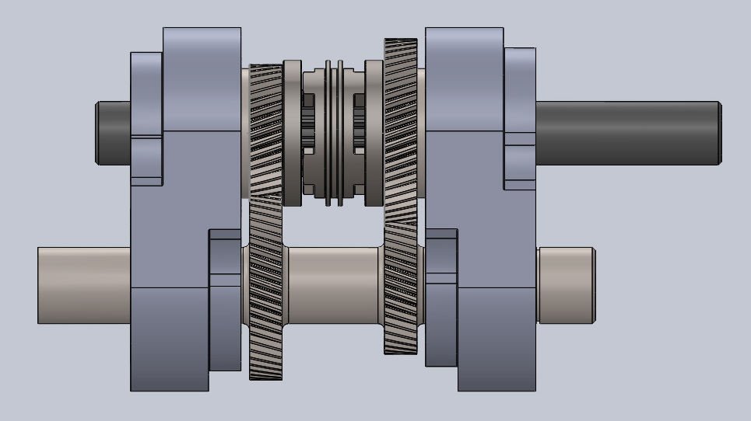
Description of the Design
Components of Transmission
Gears
Shafts
Bearings
Lube
Shifting
Assembly
Notes:
Ernesto
Requirements covered in table of requirements
Function: keeping in mind the assembly of all the parts to the transmission
These components were the

Slide 3
Detailed Table
of Requirements
Variable | Value | Units
Weight of Trans. | 50 | Lbf
Dim of Trans. | 11x10x5 | inches
Input Torque | 130 | Lbf-Ft
Output Torque | 180 | Lbf-Ft
Input Speed | 8000 | RPM
Output Speed | 11,200 | RPM
Low Gear Ratio | 1.40:1 | N/A
High Gear Ratio | 0.714:1 | N/A
Input Shaft | 1 ⅛ Inch Keyed
Output Shaft | 1.1875 Inch 28-Spline
Notes:
Ernesto
Original values found when calculating for transmission requirements in the research phase
Keeping within values set originally

Slide 4
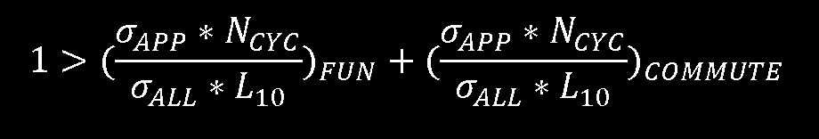
Gears
Notes:
Will

Slide 5
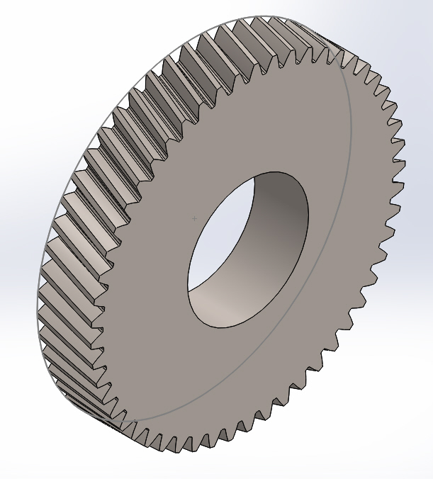
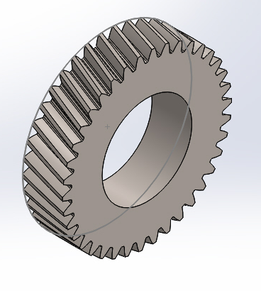
Gears (cont)
Crowned, Grade 2 Carburized steel gears with a pressure angle and helix angle of 20 degrees.
Pinion: 2.022 inch
Teeth: 38
Gear: 2.820 inch
Teeth: 53
Notes:
Will

Slide 6
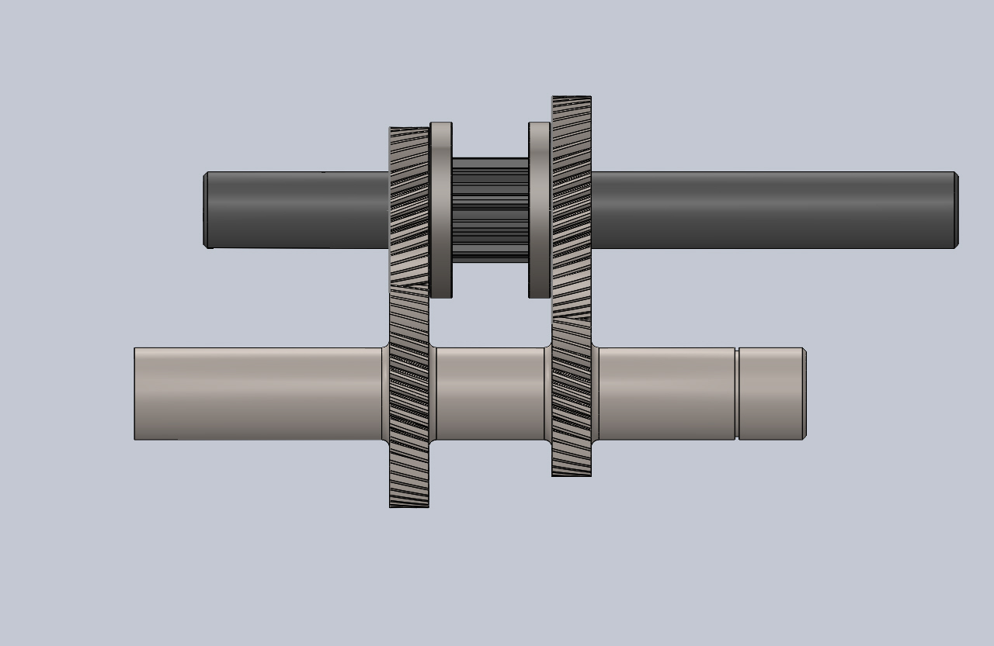
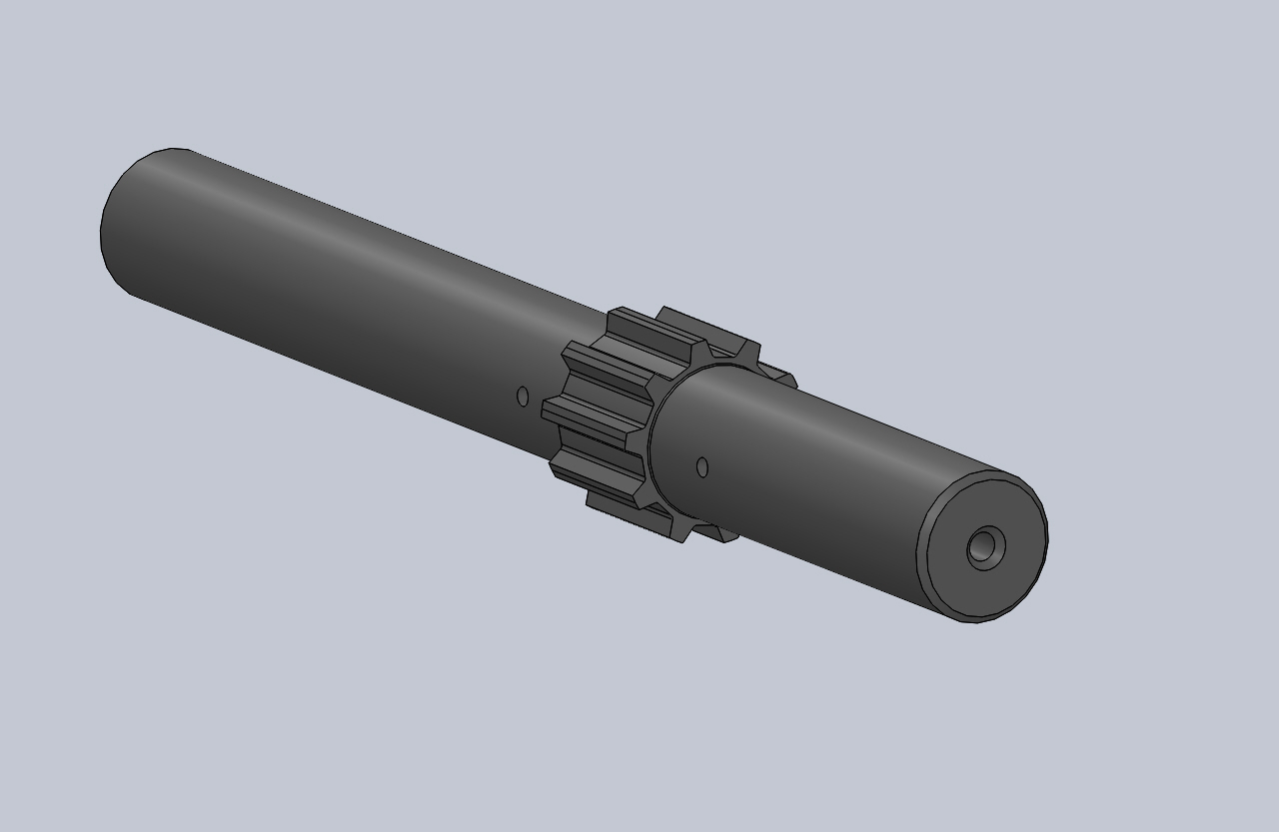
Shafts
Requirements/Considerations
Gear size
Length, spacing of components
Fluid bearing flow (Output)
Selecting Diameter
Iteration for safety factor
Fatigue, bearing rotation, deflection, critical speed
Calculations based on each gear set running 10 years individually
Notes:
Ernesto
Gear sizes: 2.022 inch, 2.820 inch
Components to consider:
Hub, collar attachment, washers, bearings, couplings/stickout, snap rings, seals
Selecting Diameter
Space for fluid bearing on output shaft.

Slide 7
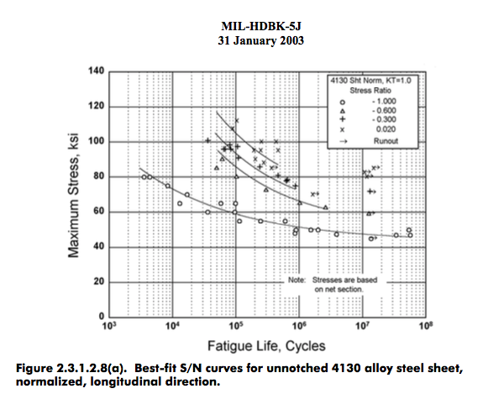
Shafts (Cont)
Input
Forged 9130 AISI Steel
1.182 inch Diameter
Life: sf = 2.80
Output
Machined 4130 AISI Steel (Hollow)
0.985 inch diameter
Life: sf = 2.11
Life calculation (Mil-HDBK-5)
Stress Ratio apx. -0.57 for both.
Interpolated from figure 10⁶ cycles
Notes:
Ernesto
Input: Motor 1 ⅛ keyed match on shaft with ____
All other safety factors much higher therefore Life is limiting safety factor
Mil-HDBK-5

Slide 8
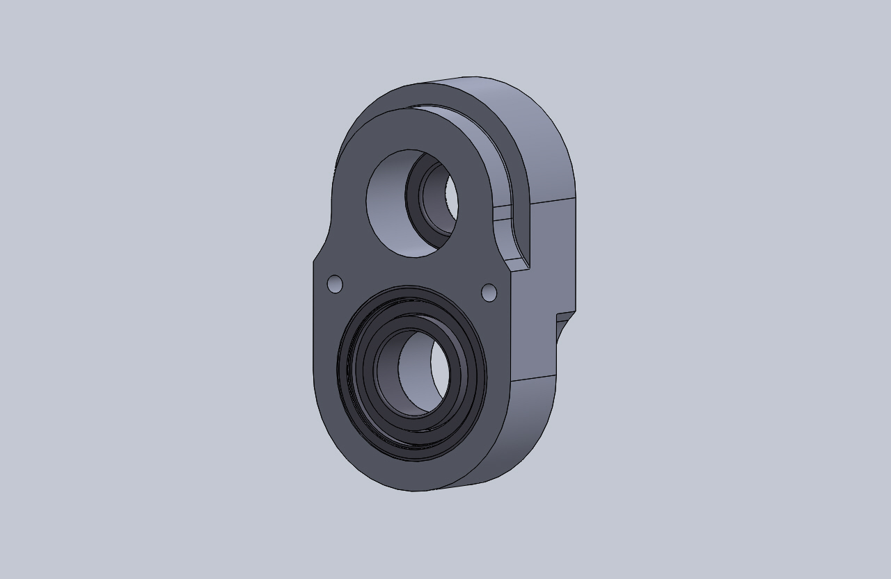
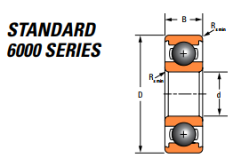
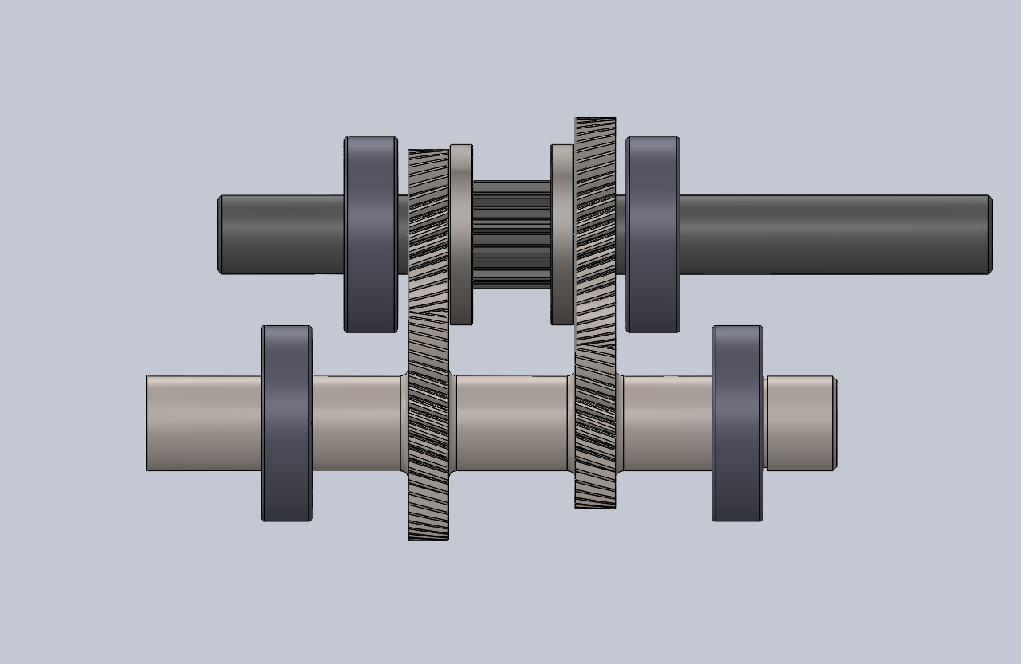
Bearings
Requirements
Life for variable loading
Bearing Functionality
Rotation
Radial and axial loads
Timken Deep Groove Ball Bearings
6206-RS / 6305-RS (input / output shafts)
Single contact seal
Fitting - .001” interference
Bearing - shaft
Bearing - housing
Notes:
Nate

Slide 9
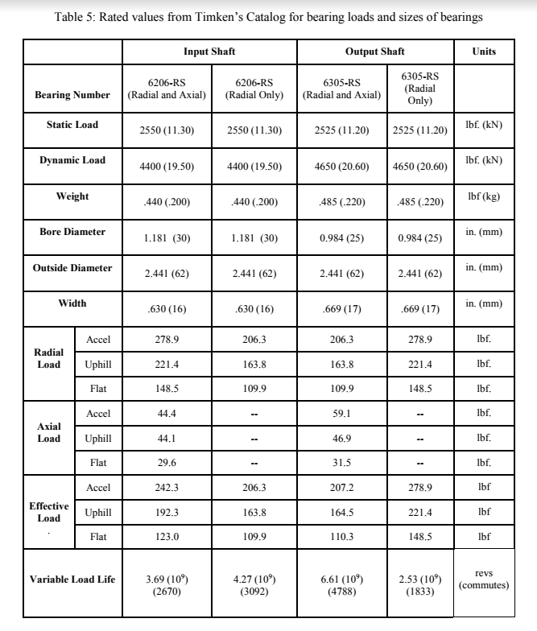
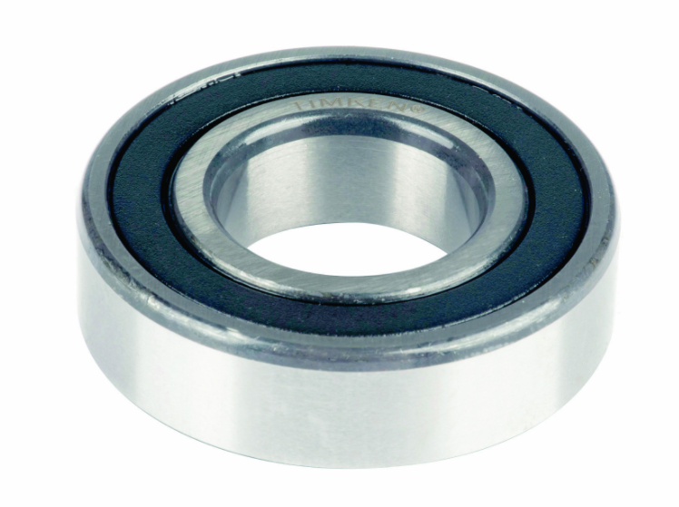
Bearings (Cont.)
Total Weight: 1.85 lb_{f}
Matlab Simulations
Variable Loading Life:
2.53 *10⁹ revs
1833 commutes
10 year life expectancy ✔
Notes:
Nate

Slide 10

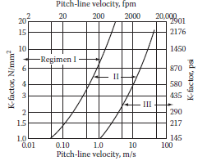
Gear Lubrication
Dudley’s Gear Design Handbook
Gearbox Lubrication Regimen Rating
Based on pitch velocity and a K-factor
Ours calculates out to Reg. III
Non EP lubricant
Select Mobil DTE Extra Heavy product
Need 1 liter for heat considerations
Notes:
Nate

Slide 11
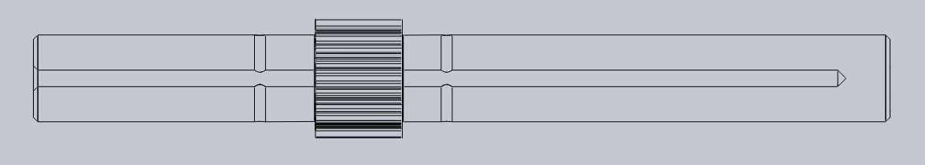
Gear Lubrication (cont.)
Oiling System
An external, electric oil pump will be used to supply oil to the fluid bearings and oiling of the gear assembly.
Oil pickup from oil pan
Oil runs through external oil filter, reservoir, and pump
Pressurized oil returned into oil passage of output shaft and delivered to gears
Notes:
Josh

Slide 12
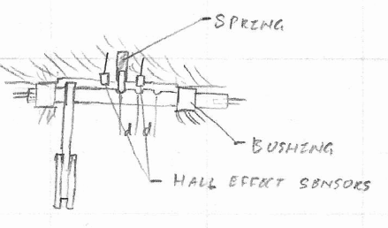
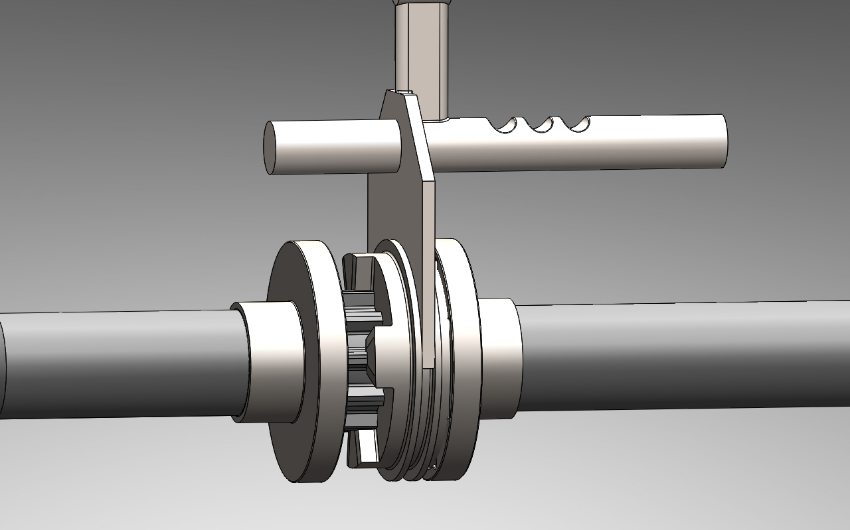
Shifting
Notes:
Will

Slide 13
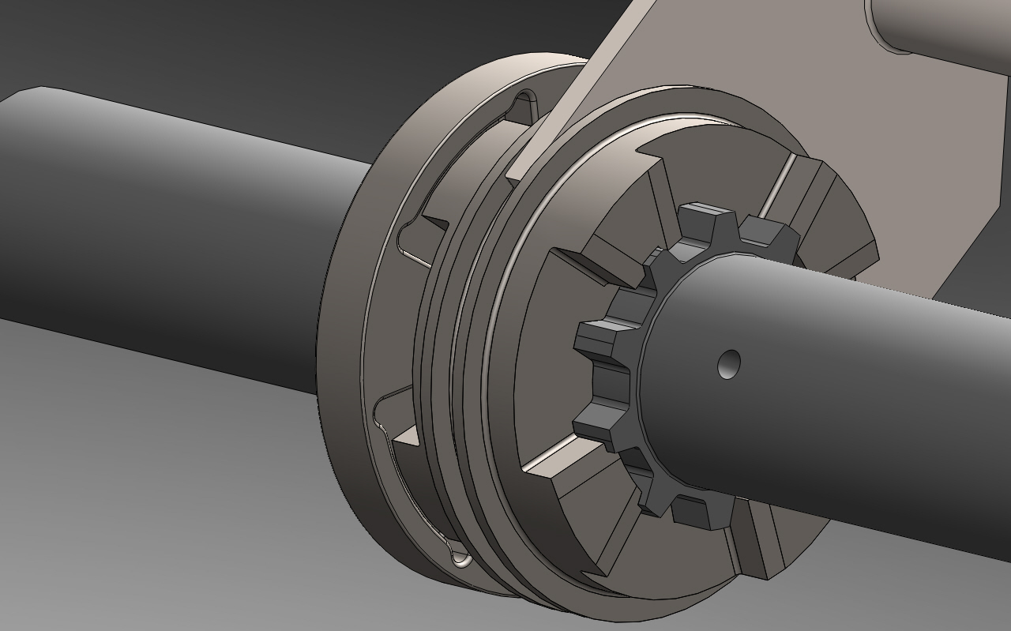
Hub/Collar
Notes:
Josh

Slide 14
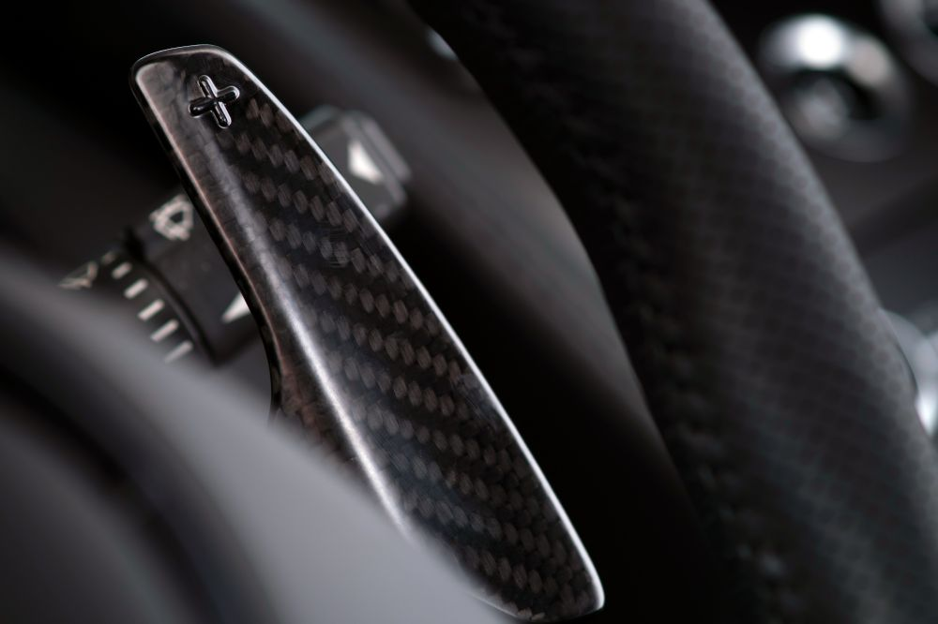
Paddle Shifters like an Aston-Martin V12 Vantage
Notes:
Will

Slide 15
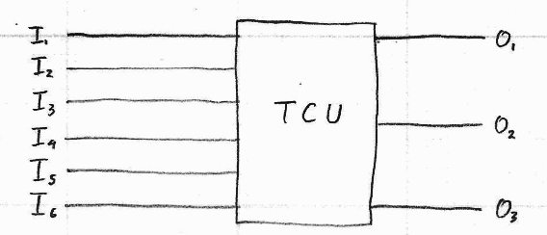
Notes:
Will

Slide 16
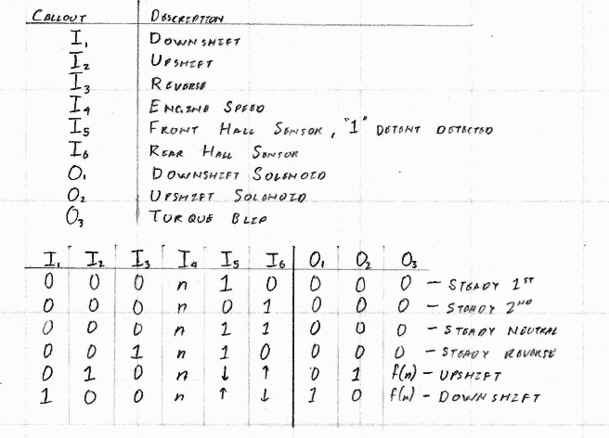
Notes:
Will

Slide 17
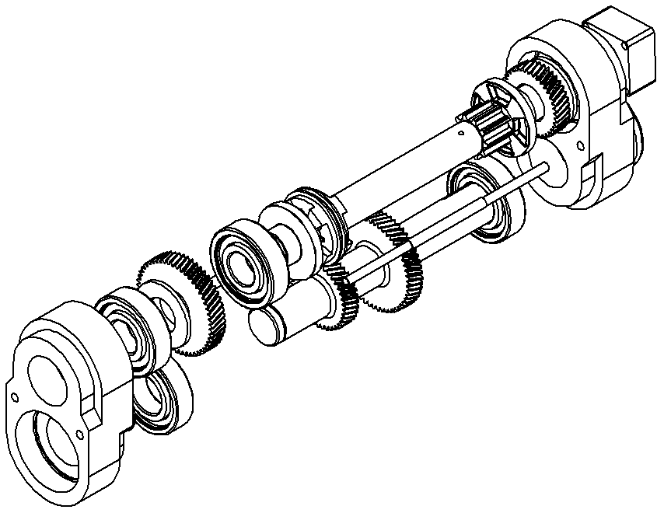
Assembly
Output shaft assembled
Bearings pressed into bearing housings and installed onto shafts
Input & output shafts installed as an assembly into the housing
Housing assembled
Oiling system installed and filled to correct level
Transmission installed into vehicle and mounted to chassis and motor
Connect shifting electronics and driveline
Notes:
Josh

Slide 18
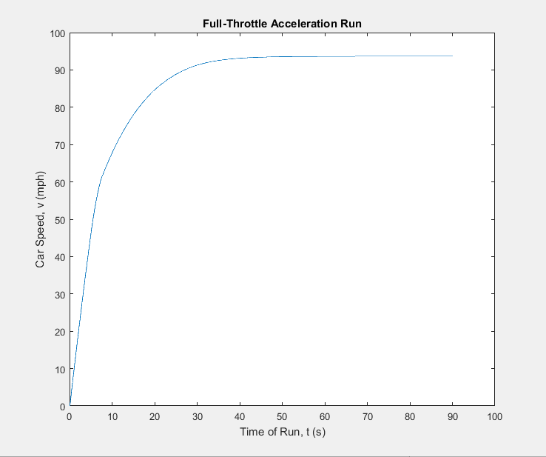
Results
0-60 in 7.4 s
Vmax=93 mph
Weight: 32.78 lb (with oil ~36.78 lb)
Dimensions: 10x10x3.7 inches
Expected life 10 years under given conditions.
Continuation
Housing design / analysis
Testing
Notes:
Ernesto?
New Weight of the transmission oil/oil pump
Weight : separately oil pump?
Expected life for: Bearings, Shafts, Gears, Shifting
Continuation
Housing analysis: Fasteners for closing case, Mounting to car brackets where needed
Seals for removable parts on case
Testing of overall transmission

Slide 19

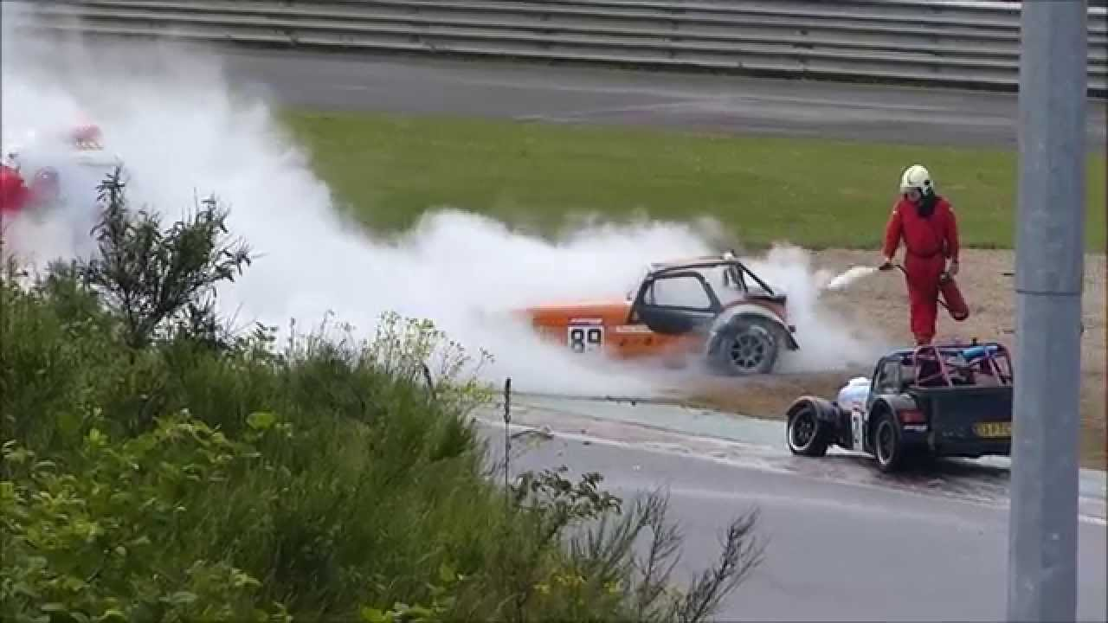
Have Fun
Notes:
Will

